Slide 1


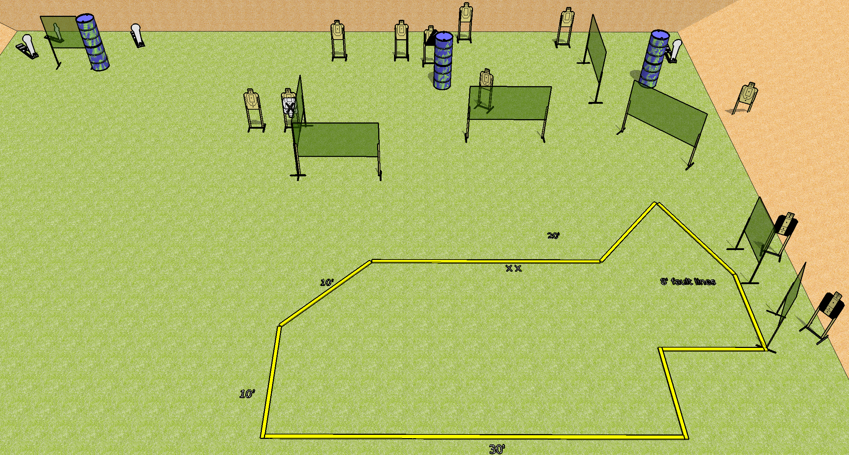
 | Dothan Gun Club – USPSA Match Don’t Tell Me What To Do Course Designer : Drew Coleman Bay: C2
Round Count 26 rounds 11 USPSA 3 colt poppers, 1 mini
Equipment List 15 wall feet 3 4’ walls 2 tux, 1 right diag 9 targets (8 + 1NS)

Slide 2
Don’t Tell Me What To Do
Written Stage Briefing
Scoring: Comstock Rounds: 26
Targets: 11 USPSA, 4 steel
Handgun start position: feet on X’s, wrists below belt. Handgun is loaded and holstered.
PCC start position: feet on X’s, stock on belt. Loaded carbine is held with both hands, safety on.
Stage Procedure: on the audible start signal, engage targets as they become available from within the shooting area.

